Slide 1


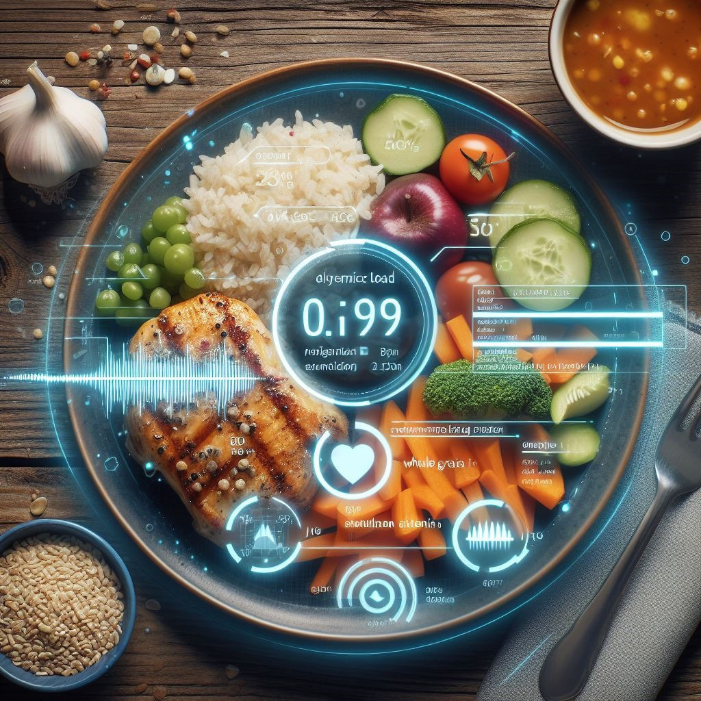

Image Assisted Dietary Assessment
GlycoSnap

Slide 2
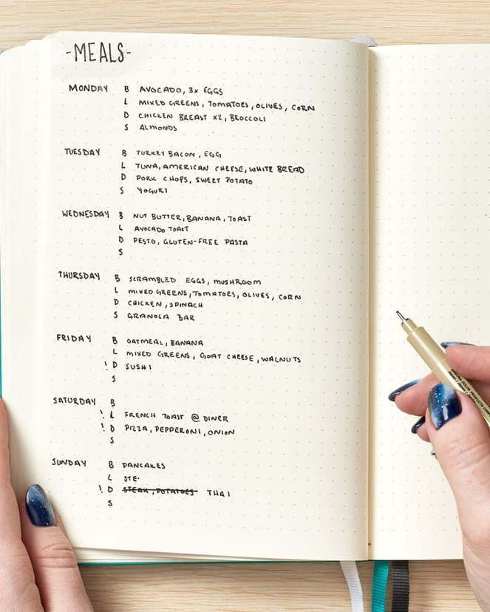
Problem
Glycemic Load Estimation:
Traditional dietary assessment methods of estimating glycemic load are inefficent and inaccessible.
Many individuals rely on food diaries and tables for glycemic load calculation and tracking.

Slide 3
What
GlycoSnap
does
Automates Glycemic Load Calculation
Improves Accuracy
Incorporates Local Kenyan Foods
Stores Meal Data

Slide 4



Features
Glycemic Load Estimation
Articles
Weekly Reviews

Slide 5
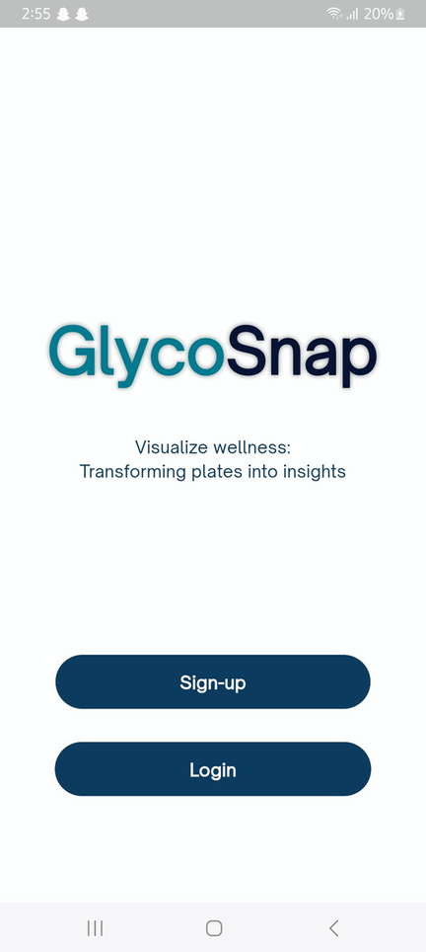
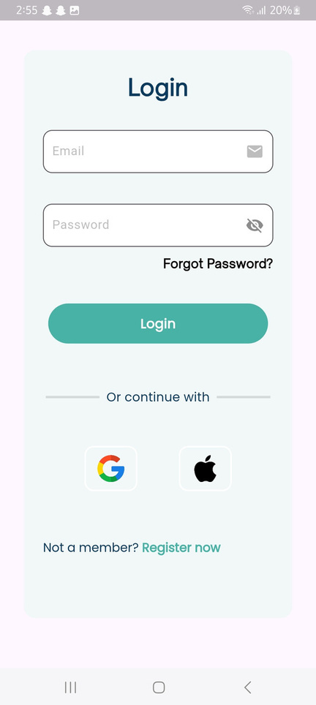
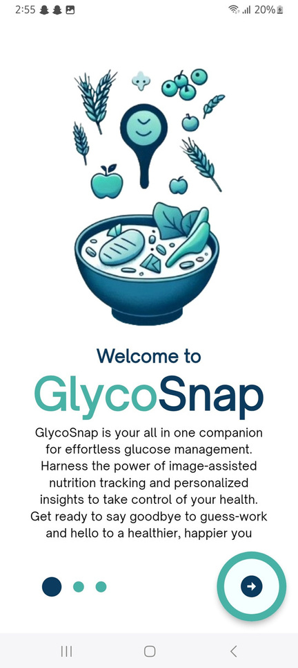
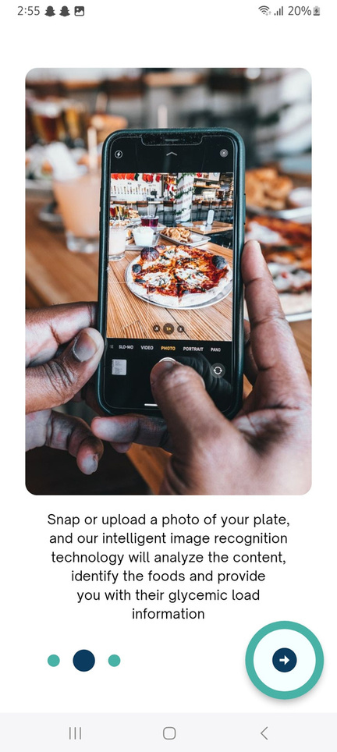
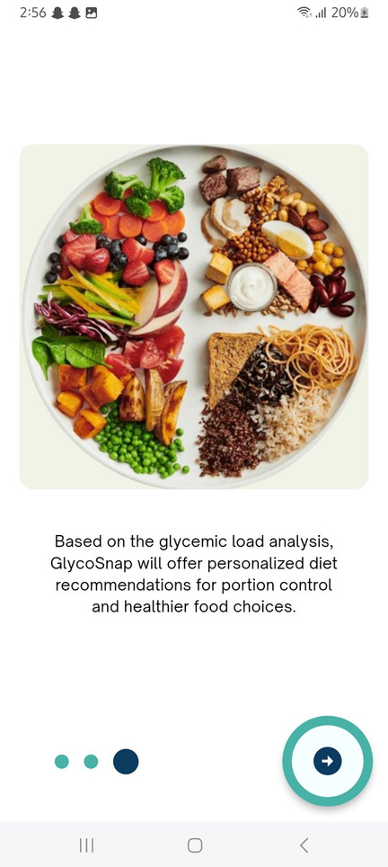
User registration/login

Slide 6
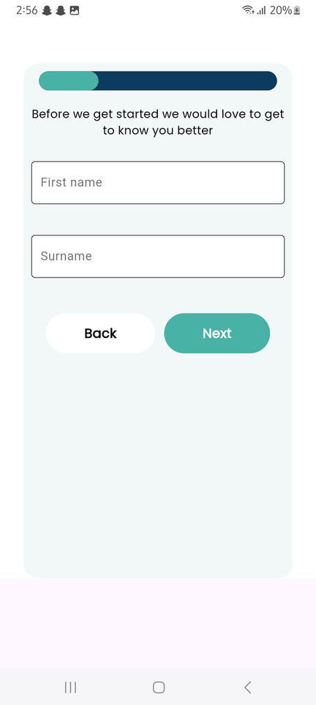
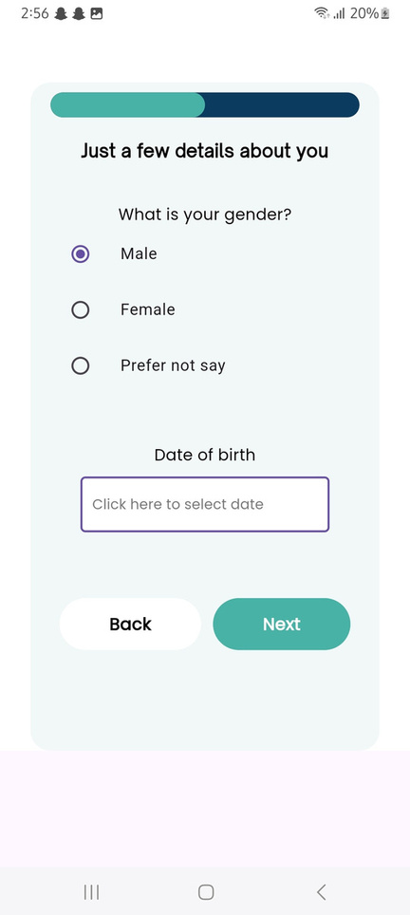
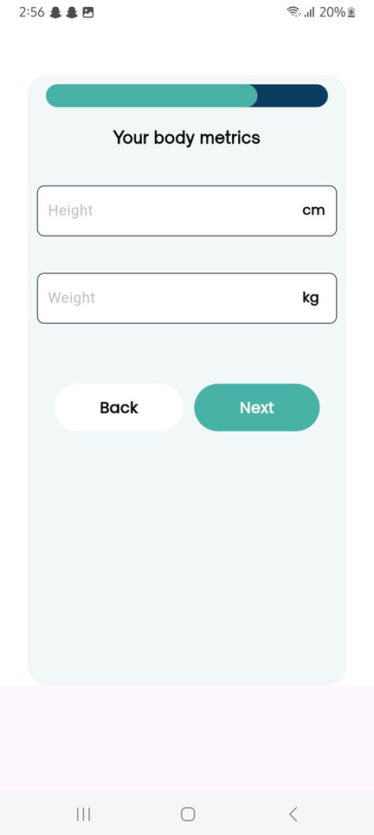
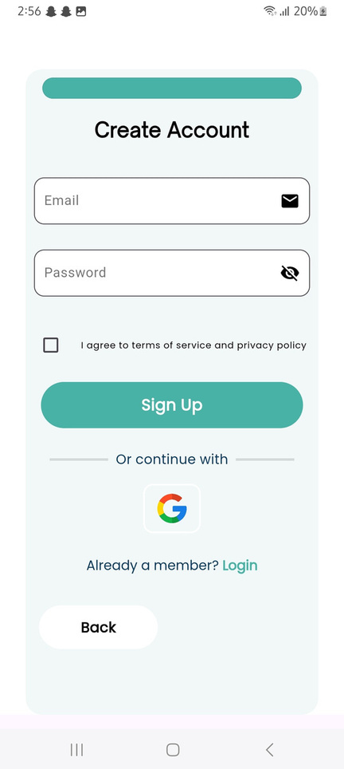
User registration

Slide 7
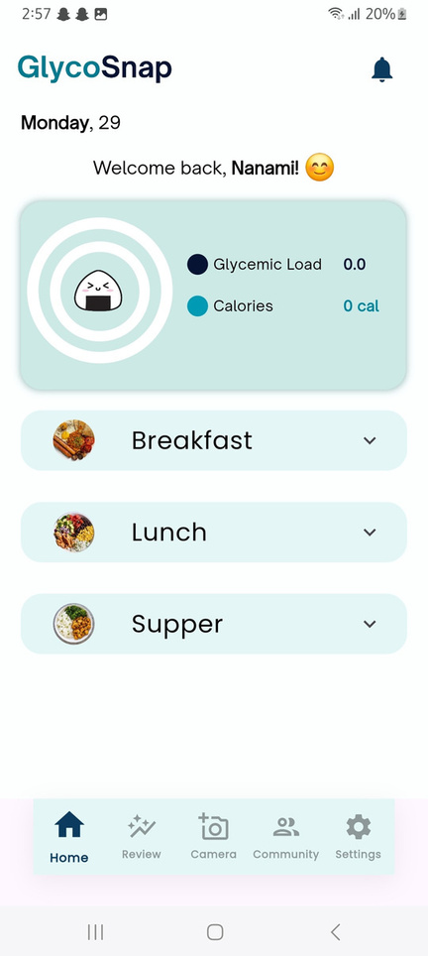
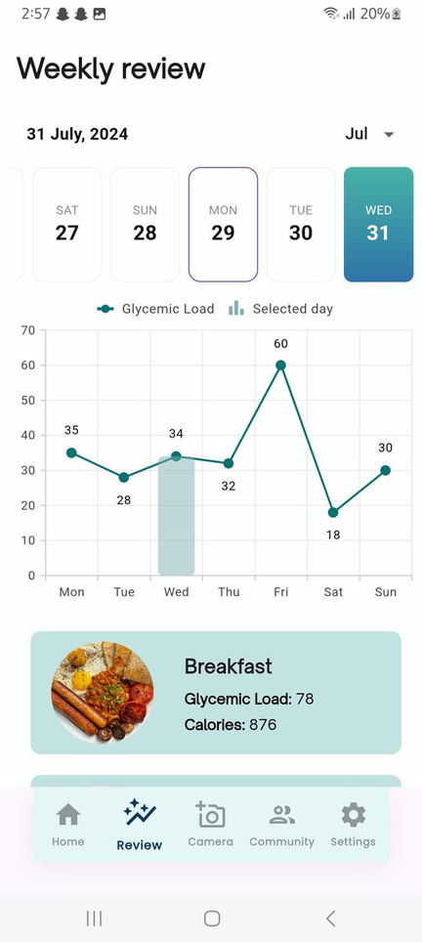
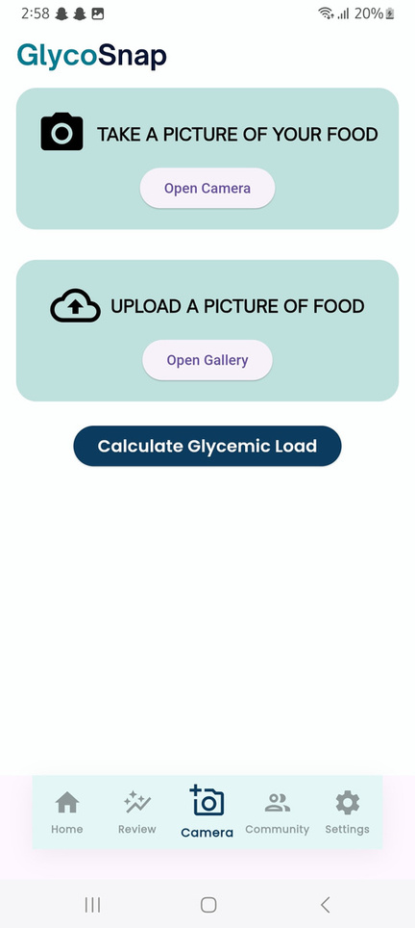
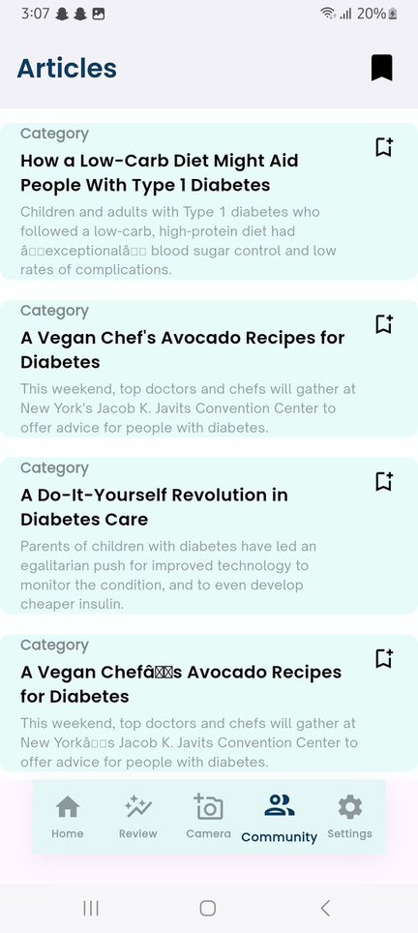
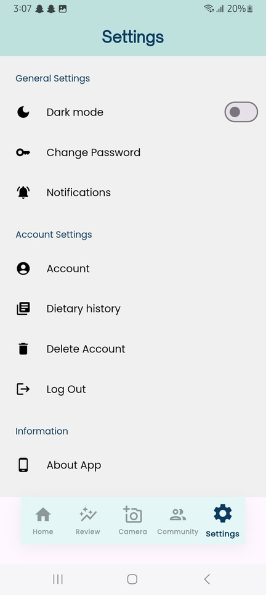
Main pages

Slide 8
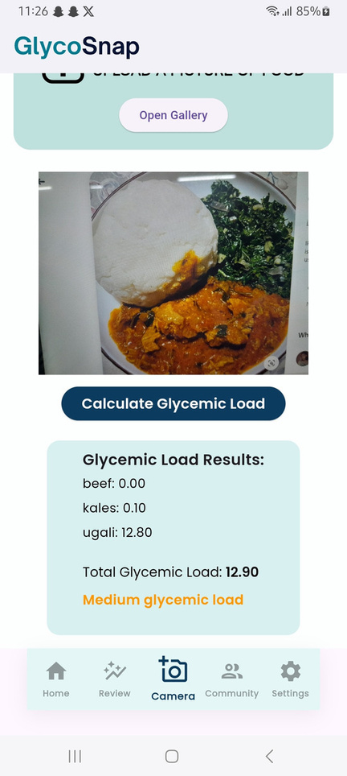
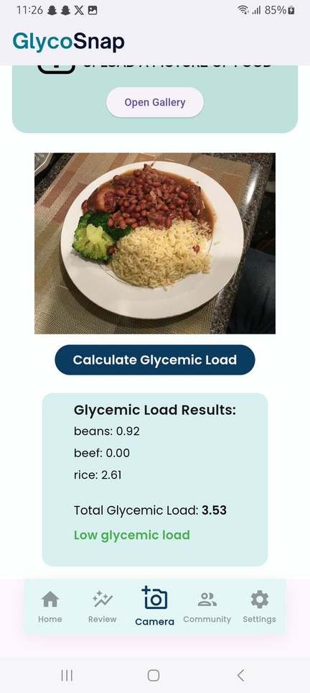
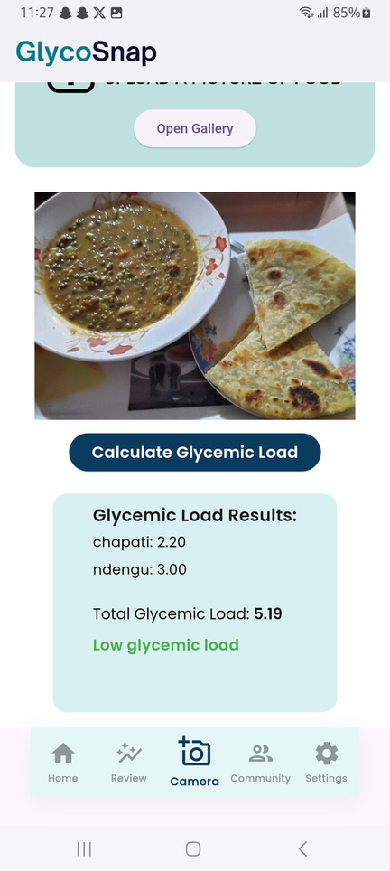
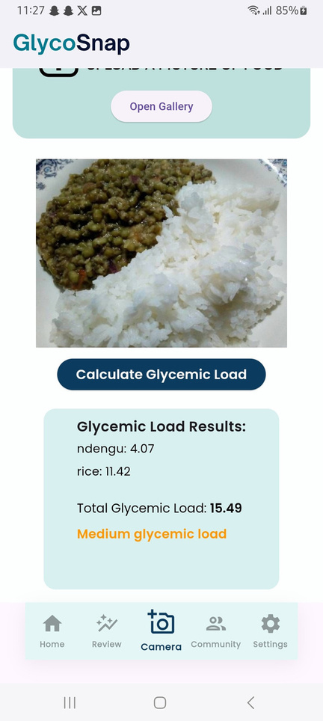
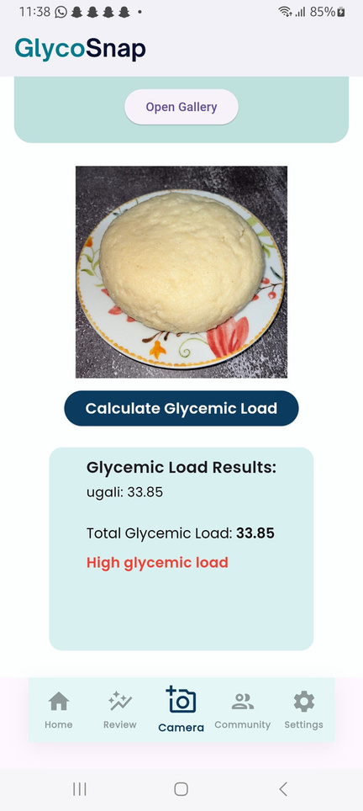
Glycemic Load Estimation

Slide 9
Market Opportunity
Growing health-tech and diabetes management market
Millions of people track food for
diabetes
fitness
general health
Potential users:
people living with diabetes
health-conscious individuals
fitness enthusiasts

Slide 10
Current food tracking apps: offer various tools for dietary tracking and analysis, but the direct estimation of glycemic load often requires manual calculation or additional resources.
GlycoSnap’s Edge: AI-driven recognition and GL calculation using a large dataset with over 5,000 images.
Competitive
Analysis

Slide 11
Future roadmap
Current features:
Food recognition, GL estimation
In progress:
Portion size accuracy
Expanding food dataset
Implementing educational chatbot
Future goals:
Integrating meal planning

Slide 12
Team
Kaigu Ann
Zawadi Muthoni
Levi Mutugi
Joy Leila
Matere Hans
Dr Lawrence Nderu
Full stack developer
Machine learning engineer
Backend developer
Machine learning engineer
Machine learning & AI engineer
Supervisor

